Slide 1
Local Clean Air Projects Showcase and Funding Opportunities
July 2023 Public Meeting
North Central Texas Council of Governments

Slide 2
Project Highlights – Clean Fleets North Texas
 | Denton Independent School District (ISD) | City of Dallas | City of Dallas
Awarded Project | Two Propane School Buses; 95% Nitrogen Oxides (NOx) Emissions Reduction | Two Diesel Hybrid Electric Crawler Tractors; 92% NOx Emissions Reduction | One Compressed Natural Gas (CNG) Powered Dump Truck; 99% NOx Emissions Reduction
Technology Replaced | Two Diesel School Buses | Two Diesel Crawler Tractors | One Diesel Powered Dump Truck
Project Geographic Area | Denton ISD, Denton County | City of Dallas, McCommas Bluff Landfill | City of Dallas
Awarded Amount Total Project Cost | $53,346 $213,382 | $249,589 $998,354 | $57,750 $183,669
Call for Project | Clean Fleets North Texas 2018 | Clean Fleets North Texas 2019 | Clean Fleets North Texas 2019
Funding Source | Texas Commission on Environmental Quality (TCEQ) Supplemental Environmental Project (SEP) | Environmental Protection Agency National Clean Diesel Funding Assistance Program | Environmental Protection Agency National Clean Diesel Funding Assistance Program

Slide 3
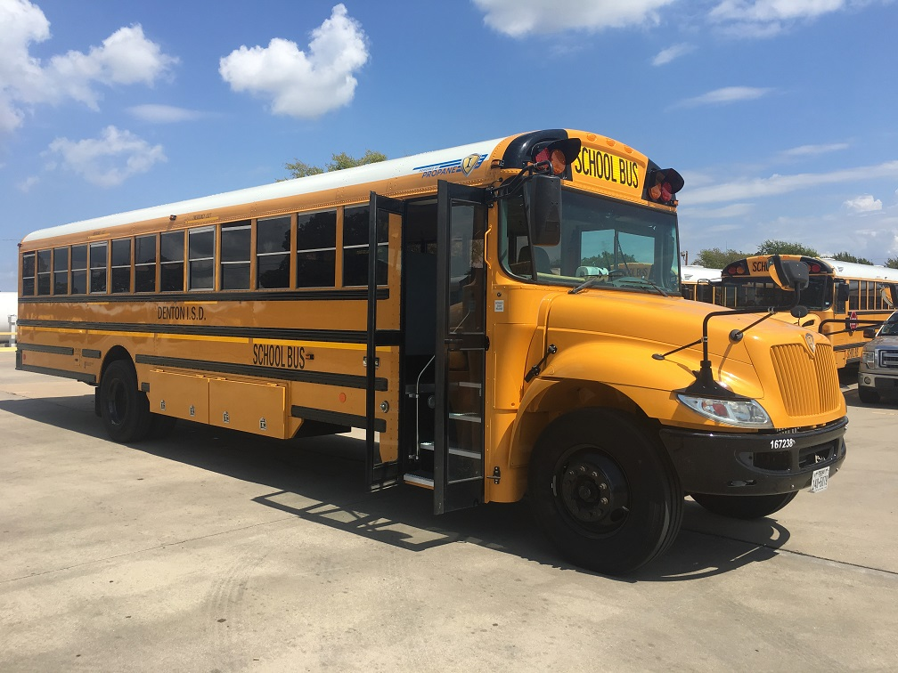
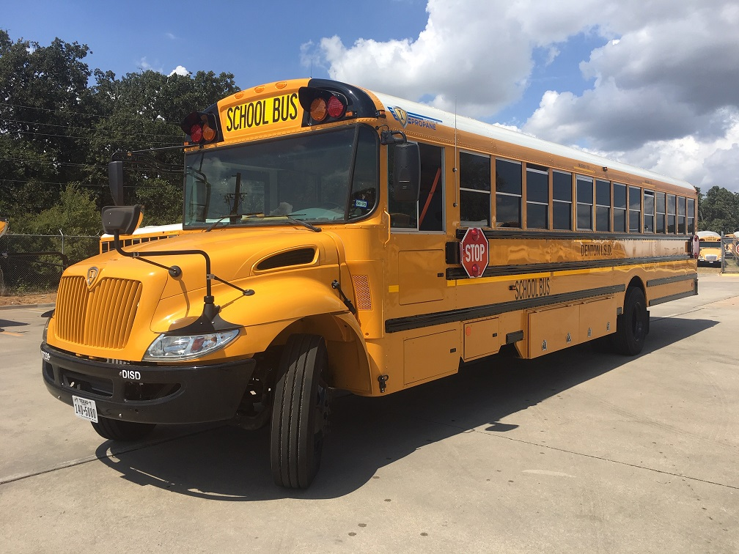
Denton ISD
Propane School Bus #1
Propane School Bus #2

Slide 4
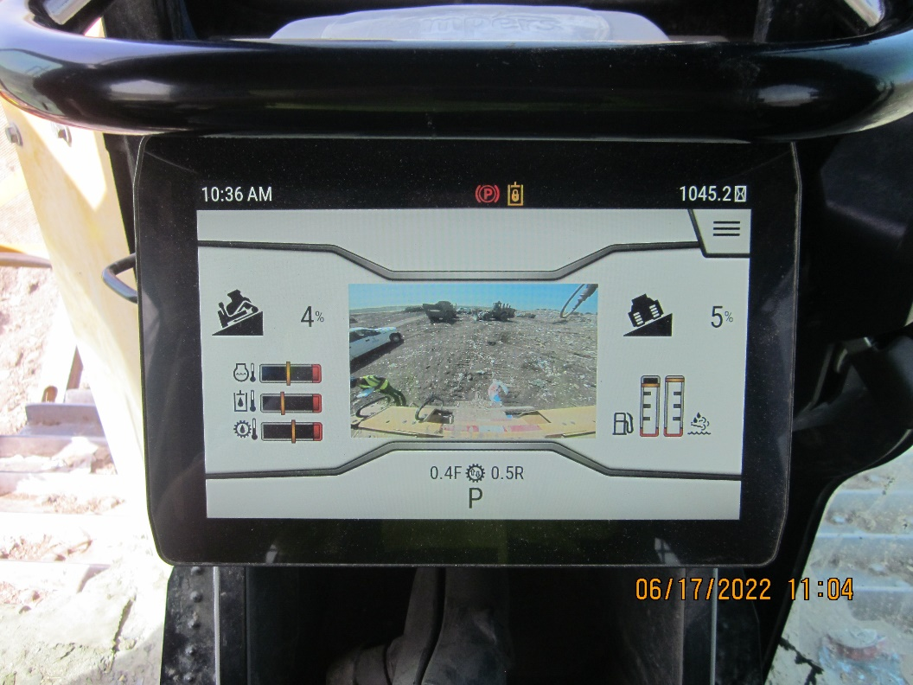
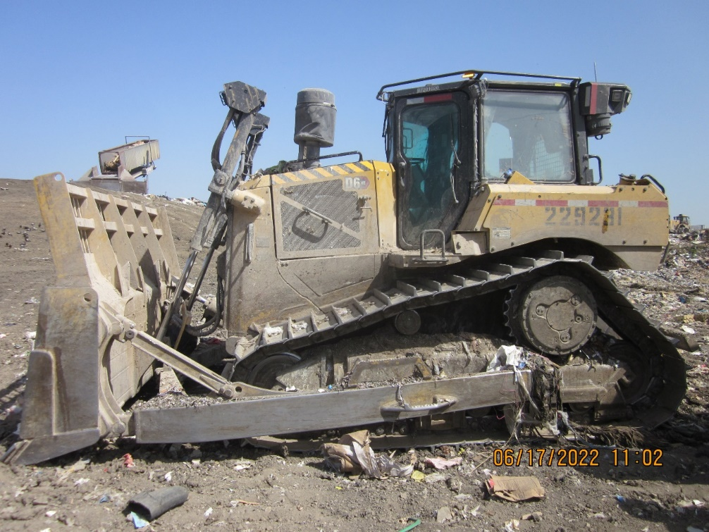
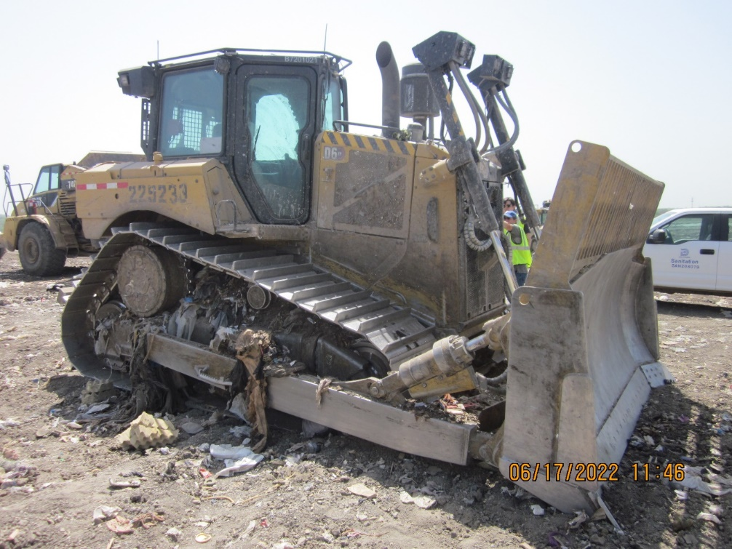
City of Dallas (April 2022)
Crawler Tractor Screen
Crawler Tractor #1
Crawler Tractor #2

Slide 5
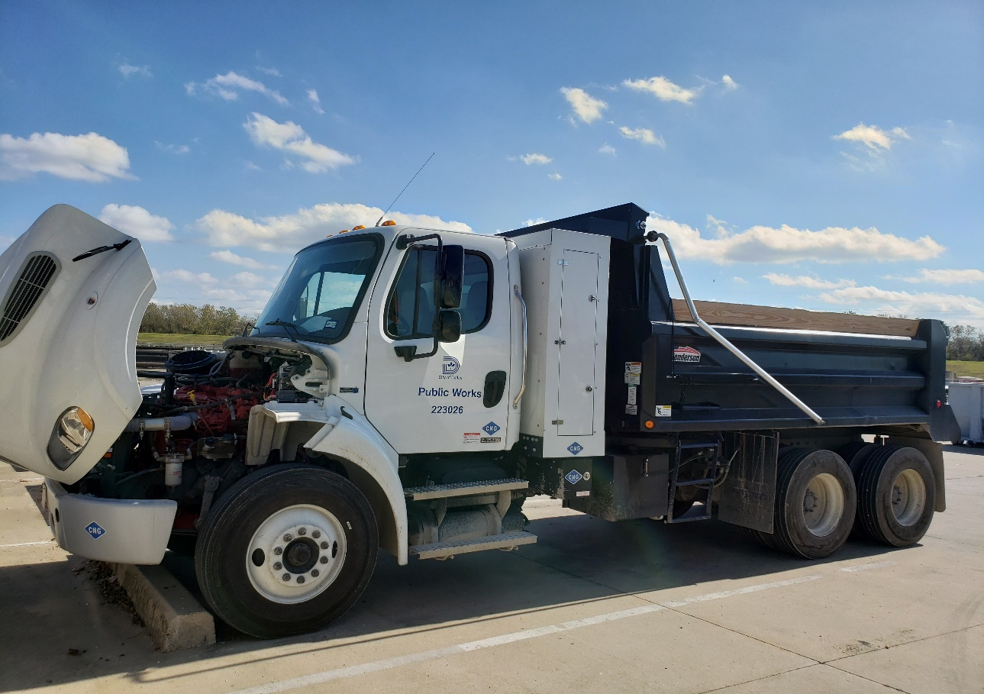
City of Dallas (August 2021)
Dump Truck Side Profile

Slide 6
Project Highlights – North Texas Emissions Reduction Project
 | Alliance Aviation Management | Romark Logistics | DHL Supply Chain
Awarded Project | Two Electric Powered Aircraft Tugs and Charging Infrastructure; 100% NOx Emissions Reduction at Location | Two Electric Powered Terminal Tractors (Yard Trucks) and Charging Infrastructure; 100% NOx Emissions Reduction at Location | Two All-Electric Terminal Tractors (Yard Trucks) and Charging Infrastructure; 100% NOx Emissions Reduction at Location
Technology Replaced | Two Diesel Engine Powered Aircraft Tugs | Two Diesel Engine Powered Terminal Tractors | Two Diesel Engine Powered Terminal Tractors
Project Geographic Area | Operating at Alliance Airport, Fort Worth (Tarrant County) | Operating in Lancaster, Texas (Dallas County) | Operating in Fort Worth (Tarrant County)
Awarded Amount Total Project Cost | $108,770 $250,597 | $288,914 $651,016 | $313,733 $697,185
Call for Project | North Texas Emissions Reduction Project 2020 | North Texas Emissions Reduction Project 2020 | North Texas Emissions Reduction Project 2020
Funding Source | Environmental Protection Agency National Clean Diesel Funding Assistance Program | Environmental Protection Agency National Clean Diesel Funding Assistance Program | Environmental Protection Agency National Clean Diesel Funding Assistance Program

Slide 7
Project Highlights – North Texas Clean Diesel Project
 | Bimbo Bakeries
Awarded Project | One All-Electric Terminal Truck and Charging Infrastructure; 100% NOx Emissions Reduction at Location
Technology Replaced | One Diesel Engine Powered Terminal Tractor
Project Geographic Area | Operating in Fort Worth (Tarrant County)
Awarded Amount Total Project Cost | $172,264 $384,001
Call for Project | North Texas Emissions Reduction Project 2020
Funding Source | Environmental Protection Agency National Clean Diesel Funding Assistance Program

Slide 8
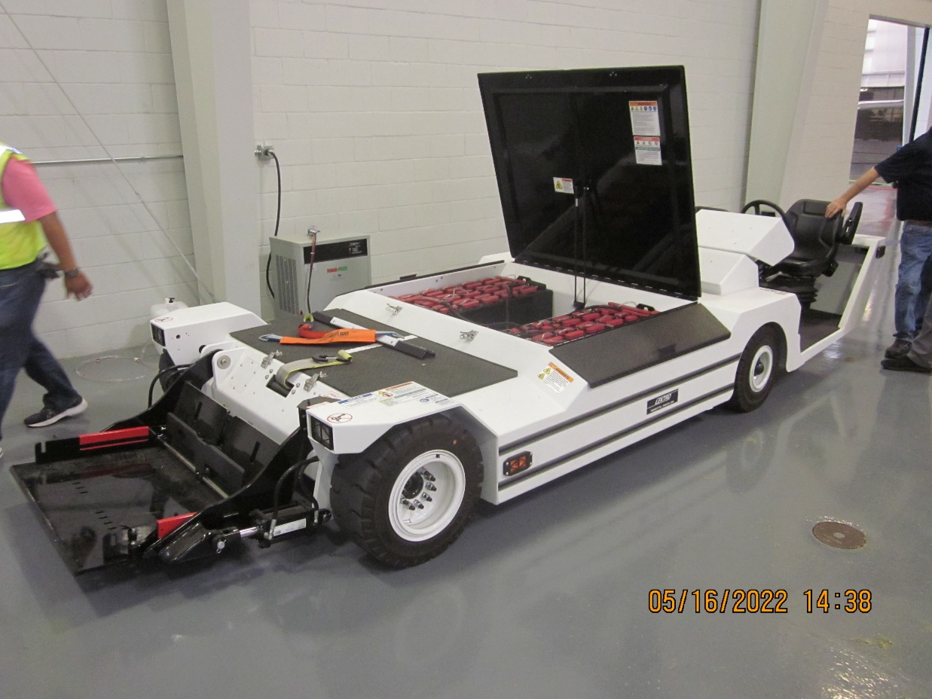
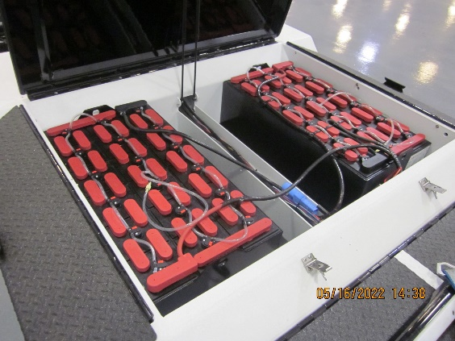
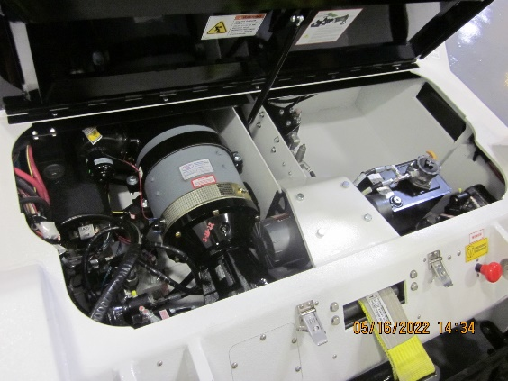
Alliance Aviation Management
Aircraft Tug Batteries
Aircraft Tug Side Profile
Aircraft Tug Electric Motor

Slide 9
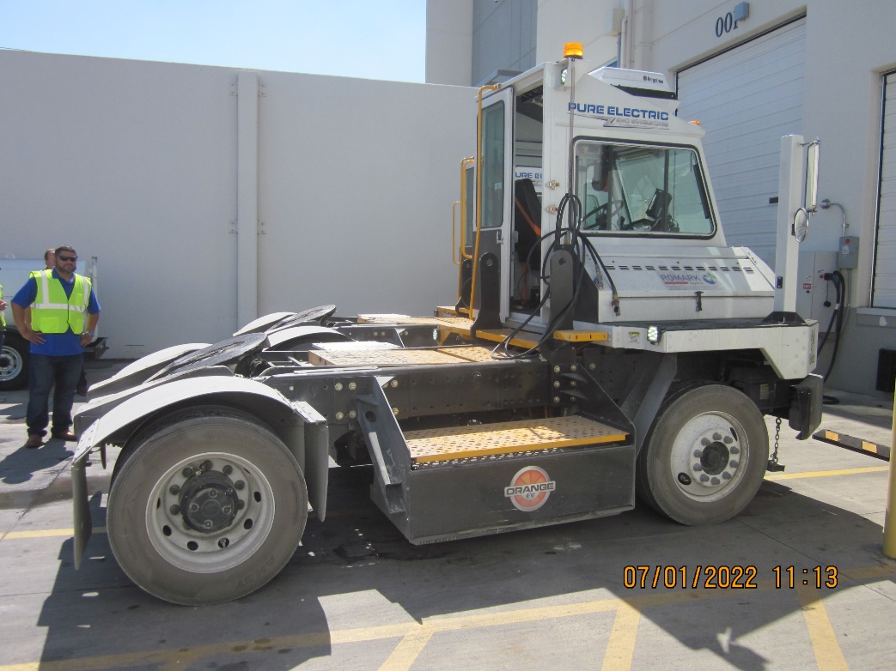
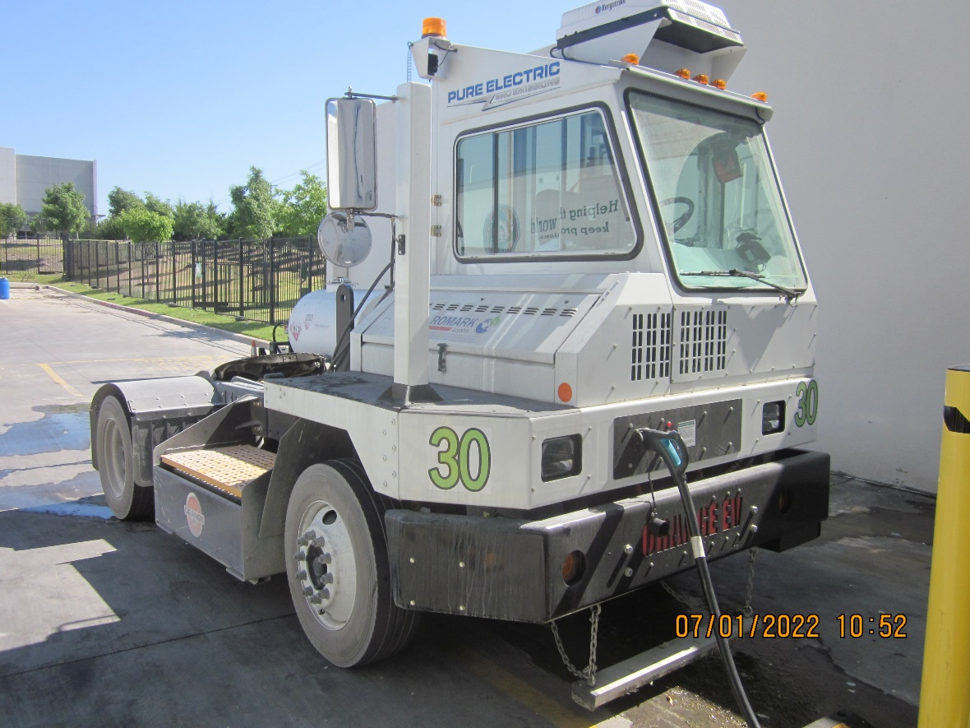
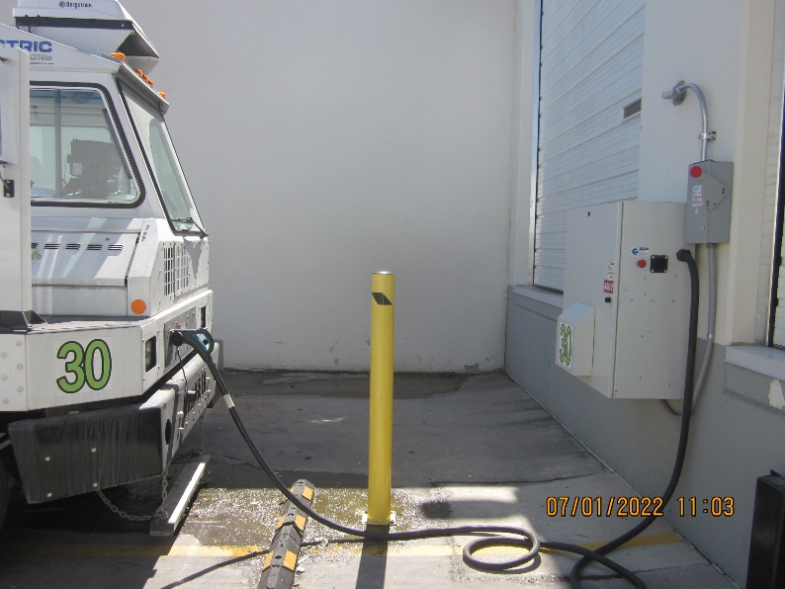
Romark Logistics
Terminal Tractor Side Profile
Terminal Tractor Front
Terminal Tractor and Charging Unit

Slide 10
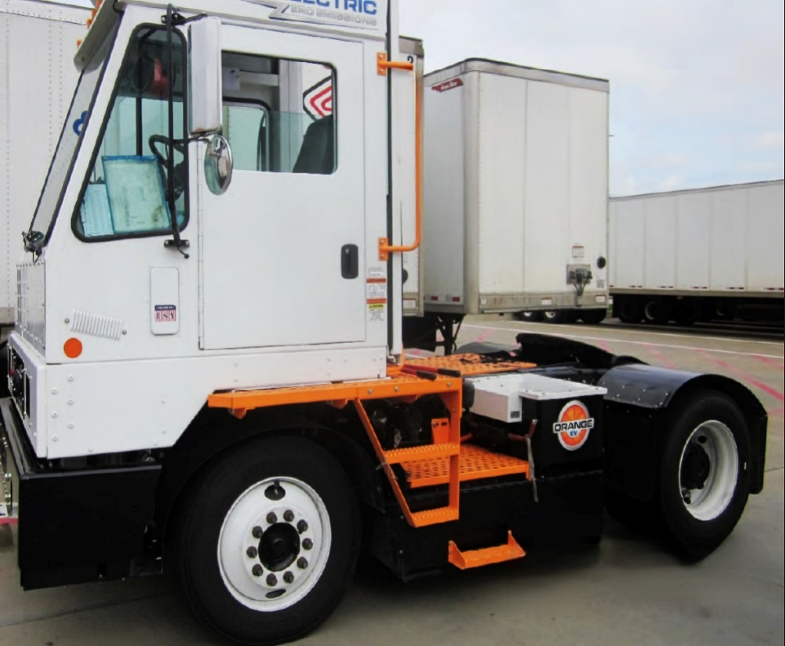
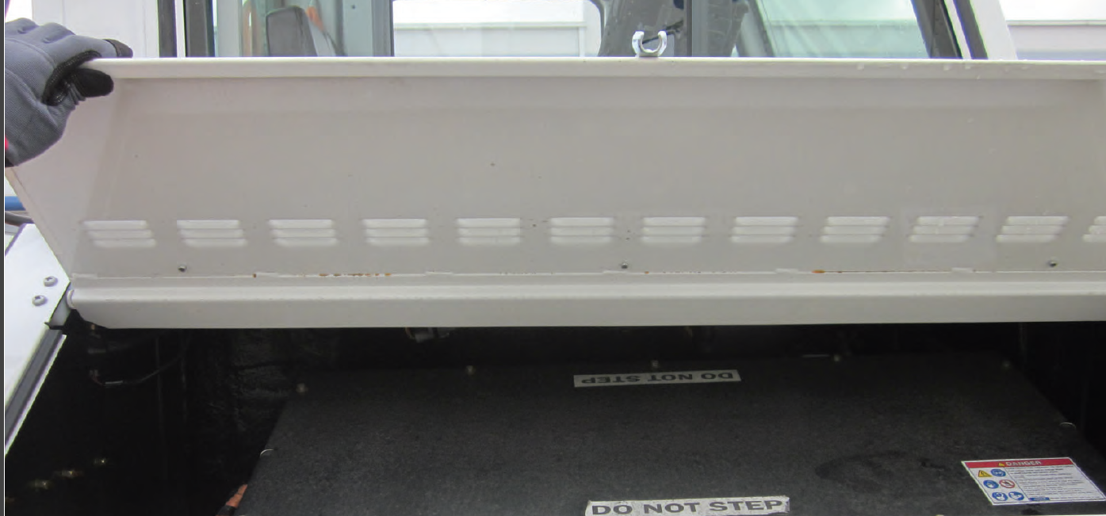
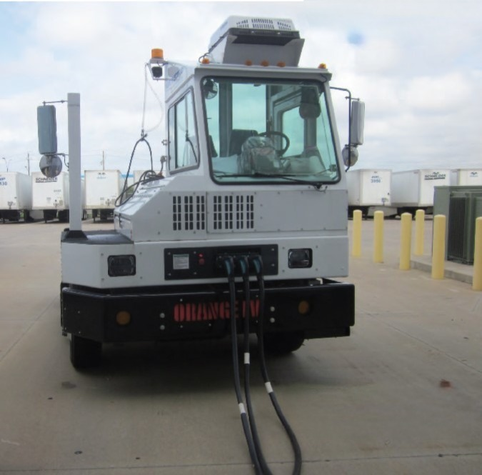
DHL Supply Chain
Terminal Tractor #1
Terminal Tractor Electrical Component Compartment
Terminal Tractor #2

Slide 11
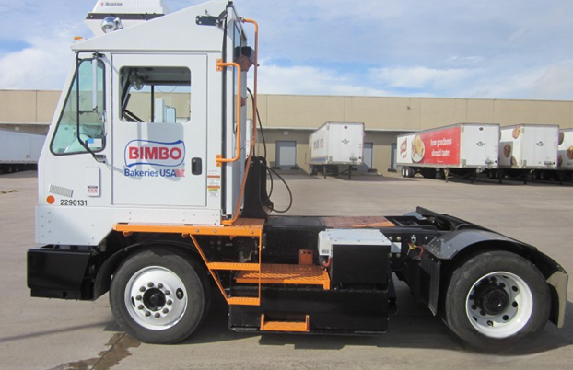
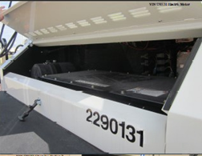
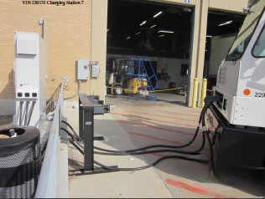
Bimbo Bakeries
Terminal Tractor
Terminal Tractor Electrical Component Compartment
Terminal Tractor, Connected to Charging Unit

Slide 12
Funding for Vehicles and Infrastructure
Program/Incentive | Eligible Activities | Funding Amount | Deadline to Apply
Alternative Fuel Infrastructure Tax Credit | Purchase of qualified residential fueling equipment, such as EV charging infrastructure | Up to $1,000 tax credit | December 31, 2032
Alternative Fuel Excise Tax Credit | Alternative fuel sold or used as a fuel to operate a motor vehicle | $0.50 per gallon (GGE for natural gas and propane) | December 31, 2024
Electric Vehicle (EV) and Fuel Cell Electric Vehicle (FCEV) Tax Credit* | New EV, PHEV, or FCEV with a GVWR of 14,000 lbs. or less with final assembly in North America | $2,500 - $7,500 tax credit | No Deadline
Previously Owned Clean Vehicle Credit* | Used EV, PHEV, or FCEV with a GVWR of 14,000 lbs. or less | Up to $4,000 tax credit | No Deadline
Light-Duty Motor Vehicle Purchase or Lease Incentive Program* | New purchase or lease of a light-duty EV, PHEV, or FCEV | Up to $2,500 | Available on a first-come, first-served basis starting September 1 of each odd-numbered year
Clean School Bus Program | Replacement of 2010 or older school buses with a new battery electric, CNG, or propane powered school bus and electric bus charging infrastructure | Up to $250,000 for non prioritized school districts Up to $395,000 for prioritized school districts | August 22, 2023
TxVEMP All-Electric Grant Program | Replacement or repower of eligible heavy-duty diesel vehicles or equipment or installation of refueling infrastructure | Up to 100% of the incremental cost of the project for government entities; Up to 75% for nongovernmental entities | First-come, first-served until August 31, 2025
www.nctcog.org/aqfunding
Local Clean Air Project Spotlight and
Funding Opportunities
Planning for EV Infrastructure

Slide 13
Contact Us
Trey Pope
Air Quality Planner
TPope@nctcog.org
817-695-9297
Jared Wright
Air Quality Planner
JWright@nctcog.org
817-608-2374
Jason Brown
Principal Air Quality Planner
JBrown@nctcog.org
817-704-2514
Amy Hodges
Principal Air Quality Planner
AHodges@nctcog.org
817-704-2508

