Slide 1
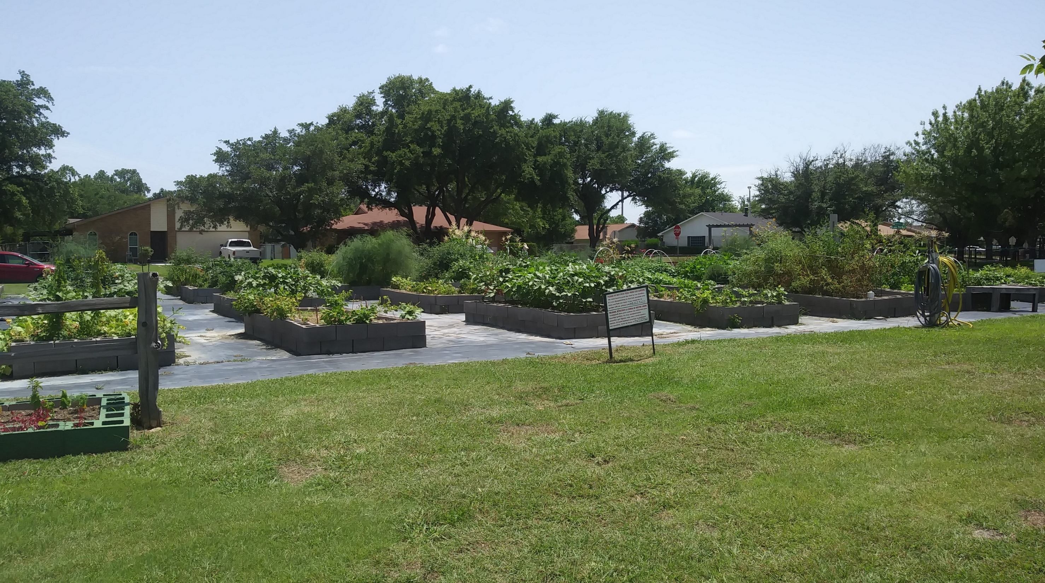
Community Gardens Public Program Guide
July Online Public Input Opportunity
Sydnee Mangini | July 6, 2023
Notes:
Add RTC logo if necessary

Slide 2
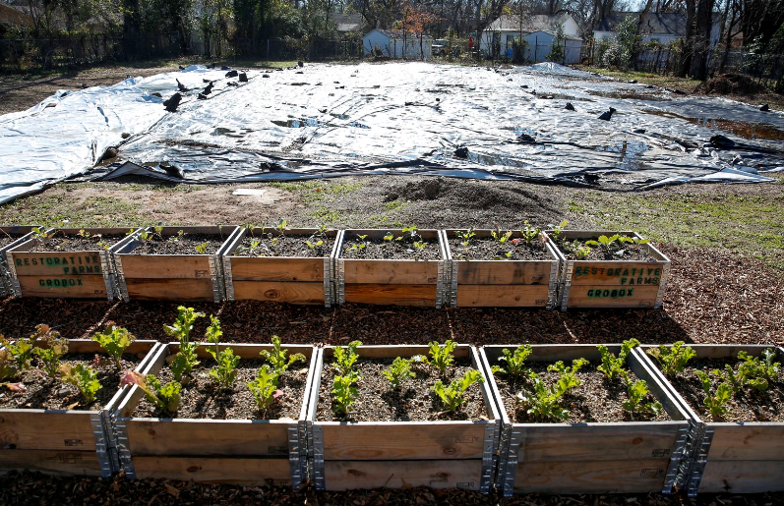
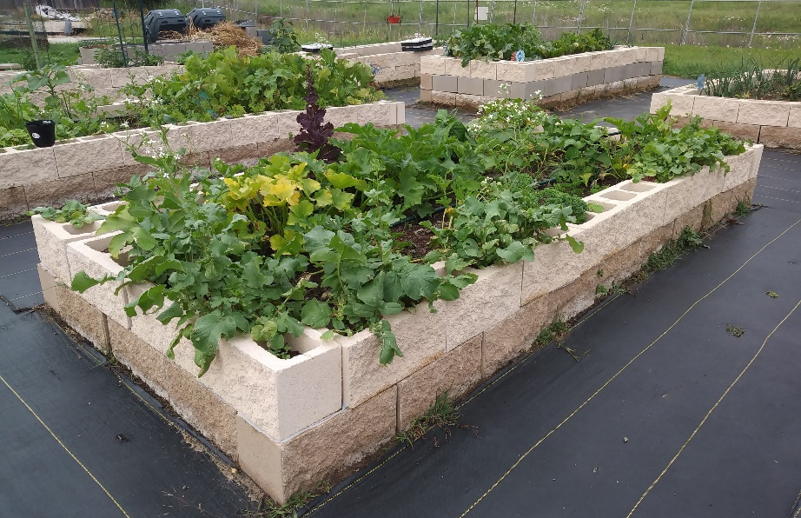
Project Background & Activities
Project goals:
Provide solutions for addressing issues related to food deserts and food access
Provide a framework for creating publicly-led community gardens programs
Encourage location of potential community garden sites on public land near transportation infrastructure such as rail stations
Act as a resource for conversations between local governments and community stakeholders
Guide development:
Reviewed current research, literature, and examples
Interviewed various staff with city-led gardens programs
Researched food access and various strategies for addressing food insecurity
Garden grow boxes
(photos courtesy of DART and City of Grand Prairie)

Slide 3
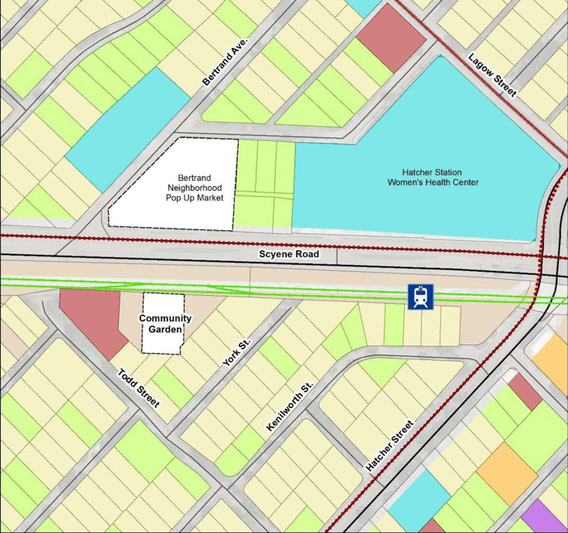
Project History
Inspired by project from the NCTCOG Blue-Green-Grey funding initiative in 2019
Project used programmatic approach to convert small, unused parcels in a DART-owned right-of-way into community garden
Community garden is in a food desert near transit center and farmers’ market
Hatcher Station Community Garden Pilot Project
Community Gardens Public Program Guide

Slide 4
Community Gardens Overview
Characteristics:
Locations can be urban, suburban, or rural
Can grow a variety of plants throughout the year in TX
Consists of either communal or individual plots
Managed or owned by various types of organizations
Benefits of community gardening:
Can improve quality of life
Catalyze neighborhood/community development
Create opportunities for social interaction, community-building, recreation, exercise, therapy, and education
Reduce family food budget
Increase food access/healthy food options
Promote local food production/economies
Conserve resources
44% increase in garden plots in city parks since 2012
More than 29,000 plots in city parks in largest 100 U.S. cities
Around 62 community gardens sites in the region currently
Sources: Trust for Public Land & American Community Gardens Association (ACGA)
Community Gardens Public Program Guide

Slide 5
Types of Community Gardens
Plot garden
Subdivided, family-sized garden plots
Range from 100 to 500 square feet
Learning garden
Raised-beds or plots on school grounds
Entrepreneurial garden
Focus on how to grow and sell food
Raised-beds or plots located at hospitals, nursing homes, etc.
Pollinator garden
Include plants that support environmental and ecological health/aesthetics
Cooperative garden
One large garden managed by various community members
Therapeutic garden
Purpose is to improve mental and/or physical health of patients
Sources: North Carolina State Extension & American Planning Association (APA)
Community Gardens Public Program Guide

Slide 6
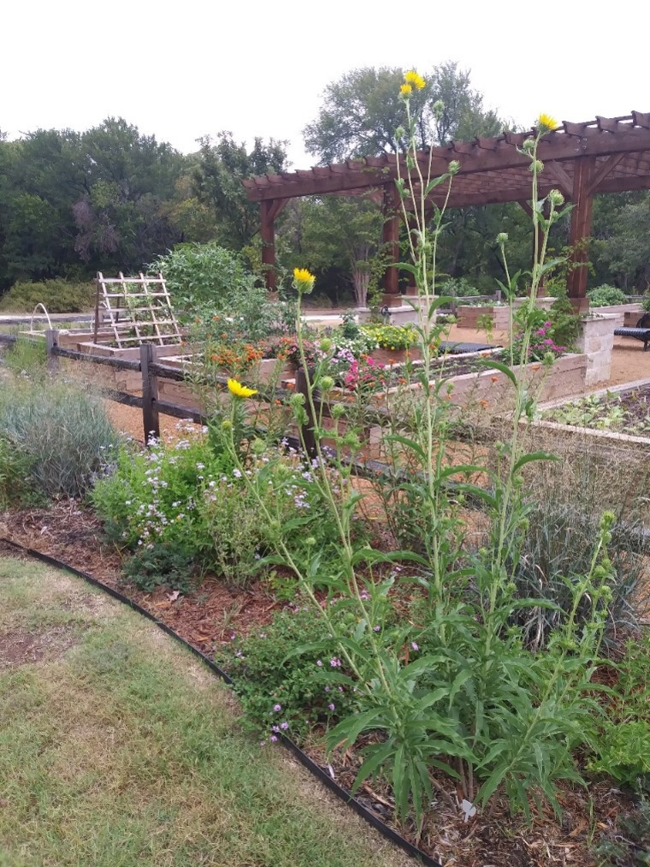
Local Government-Led Programs
Public programs can:
Have dedicated staff, funding, and resources for the program
Identify plots of land for gardens which can be a strategy for low-cost redevelopment
Provide consistent maintenance/upkeep
Manage the regulatory aspect of plots/land use
Support collaboration through established relationships and partnerships
Provide city-wide educational opportunities
The guide focuses on:
Implementing city-led garden programs (likely plot gardens) near transit with bicycle and pedestrian access
Cities initiating, implementing, and managing the garden program
Allen Community Garden
(photo courtesy of City of Allen)
Community Gardens Public Program Guide
Source: International City/County Management Association

Slide 7
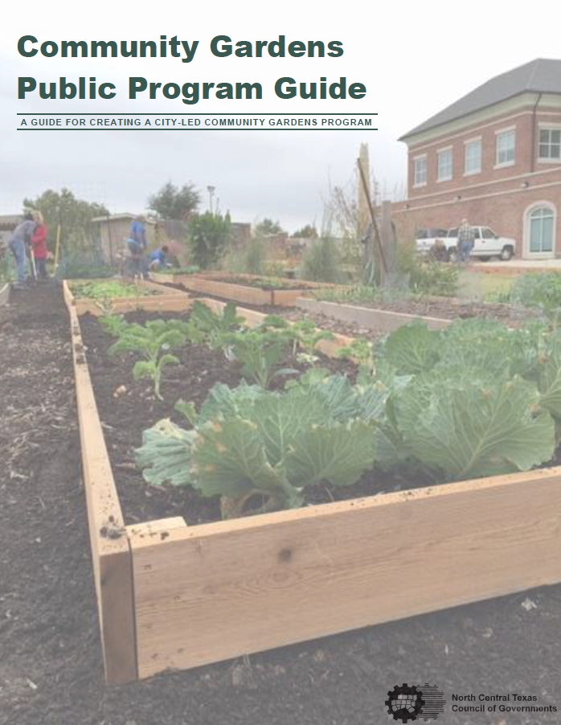
Community Garden Public Program Guide
Guide components
Introduction to community gardens
Community gardening in the region
Overview of food access
Appendix
Program tools/resources
Example agreements/templates
Garden start-up resources
Other information/resources
Steps to start up a program
Challenges/solutions for garden programs
Community Gardens Public Program Guide

Slide 8
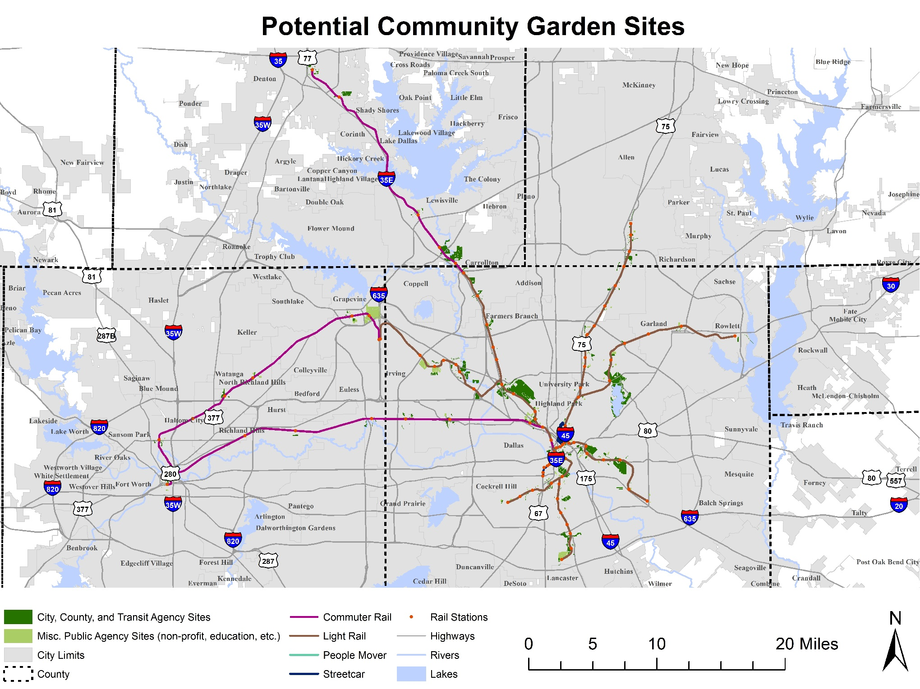
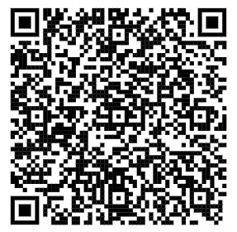
Site Analysis
Site criteria:
Publicly-owned properties (city, county, transit agency, non-profit organizations, ISDs, etc.)
Located within 0.5 miles of transit station and existing bicycle/pedestrian facilities
Less than 10% slope
Summary statistics:
12,555 acres identified across Collin, Dallas, Denton, and Tarrant counties
68 different cities and organizations own properties

Slide 9
Steps for Implementation
1. Determine resources
2. Identify goals and purpose
3. Establish stakeholders
4. Choose framework
5. Develop agreements
6. Develop applications and timeline
7. Garden education
8. Program implementation
9. Application review
10. Construct gardens
11. Evaluate program

Slide 10
Program Considerations
Recommendations:
Ensure you have a dedicated staff member/person for program
Establish stakeholder group
Select the framework and goals that work best for your city and stakeholders
Engage the public/promote the program
Challenges:
Funding/budget constraints
Garden locations/use conflicts
Lack of staff time/availability
Consistent maintenance and upkeep
Regular coordination

Slide 11
CONTACT US
Shawn Conrad, PhD
Principal Transportation Planner
sconrad@nctcog.org
Sydnee Mangini
Transportation Planner
smangini@nctcog.org
Community Gardens Public Program Guide

