Slide 1
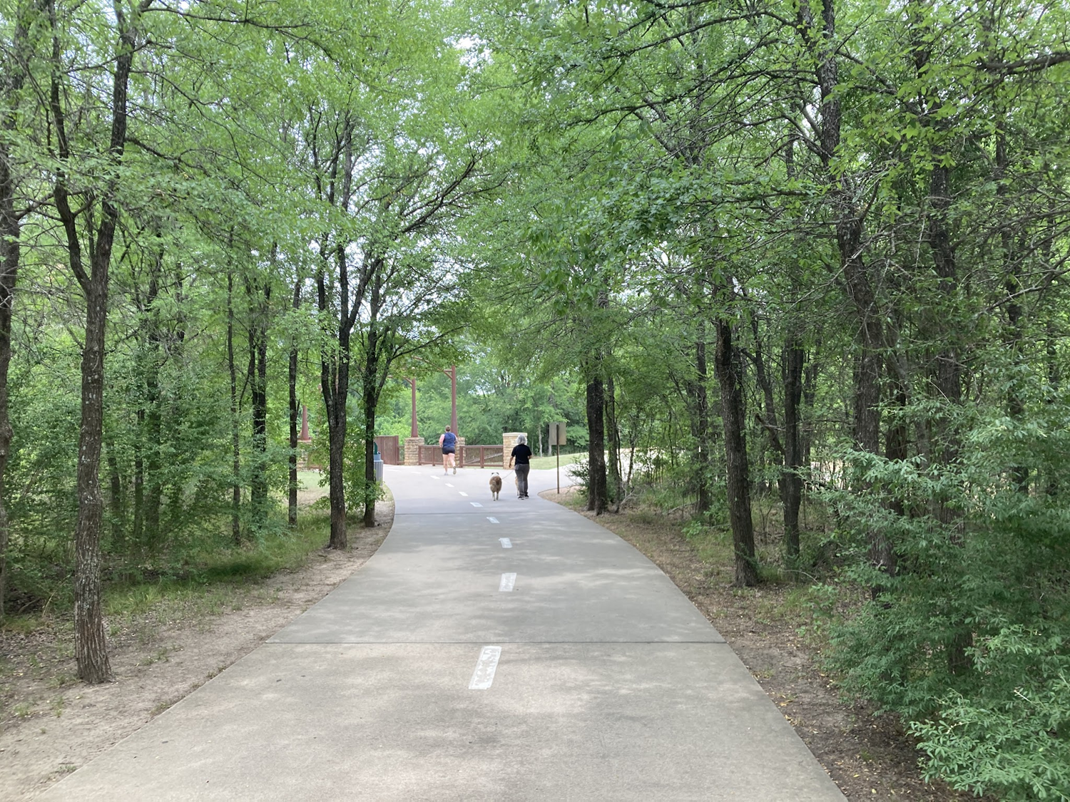
DFW Discovery Trail Update
NCTCOG PRESENTATION
SHAWN CONRAD | NCTCOG Public Meeting | July 2023
Notes:
Add RTC logo if necessary

Slide 2
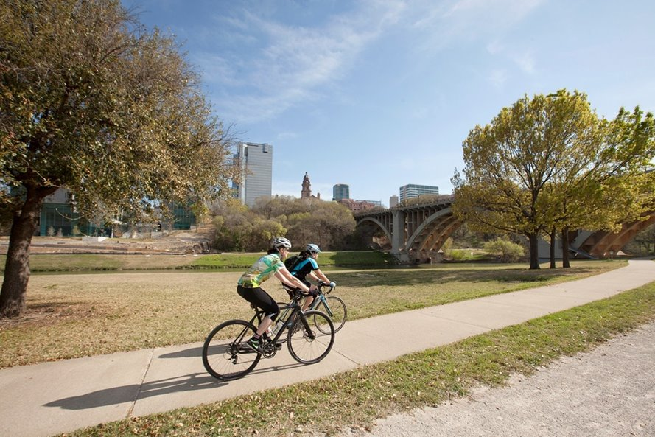
DFW DISCOVERY TRAIL
At completion, 66-mile multi-use trail spanning five cities: Fort Worth, Arlington, Grand Prairie, Irving, and Dallas
>50 miles existing, 12 miles under construction
Majority of trail completion expected in 2024

Slide 3
VISION FOR THE TRAIL
In 2013, mayors and staff of the five cities partnered to make trail vision a reality:
Uninterrupted 66-mile paved trail
Recreation, transportation, events, and exploration uses
Regional, state, and national attraction for events and tourism

Slide 4
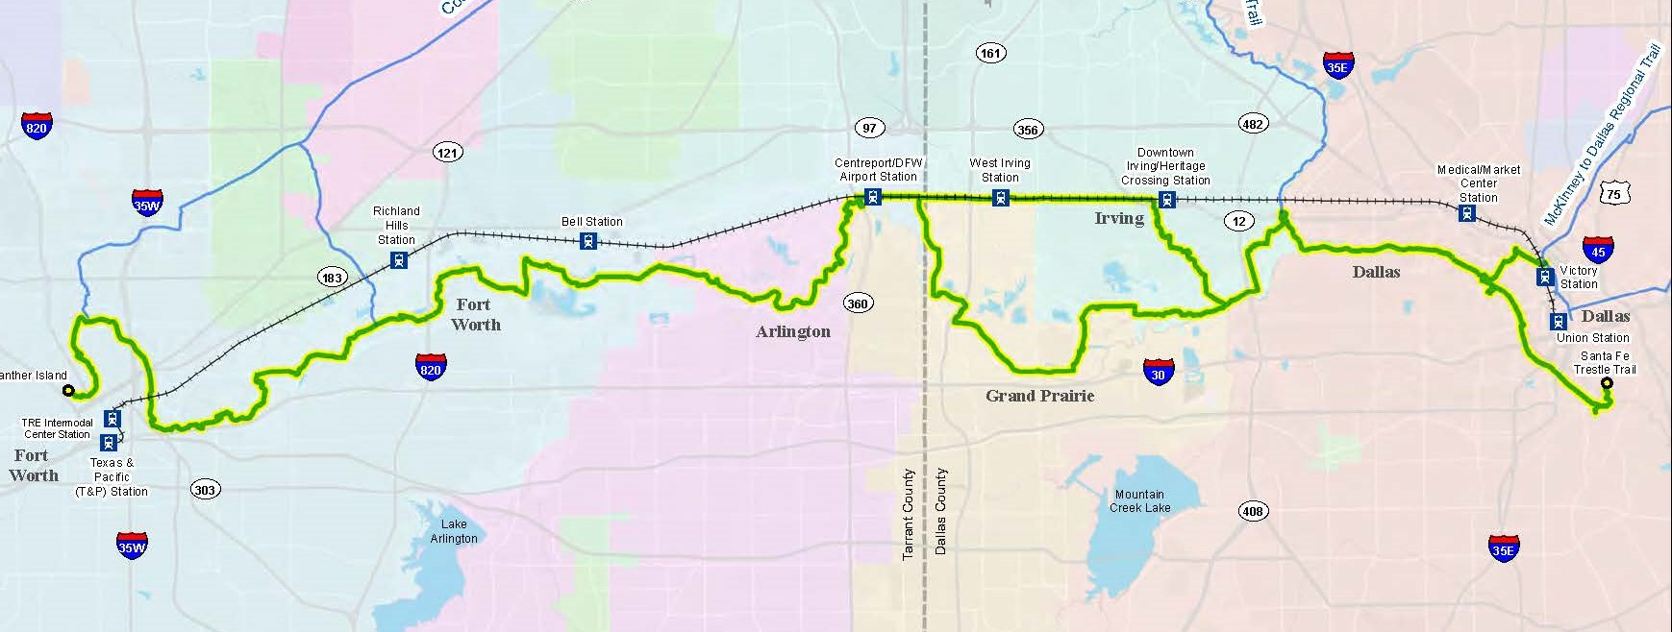
DFW DISCOVERY TRAIL
DFW Discovery Trail Update | www.nctcog.org/dfwdiscoverytrail

Slide 5
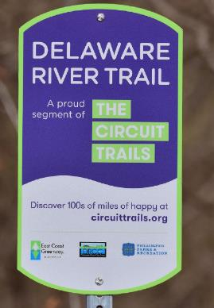
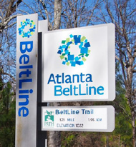
TRAIL BRANDING & WAYFINDING PROJECT GOALS
Create a unified name, brand and signage package with cobranding of local trails
Recommendations for infrastructure to hold major regional and national events
Integrated regional 911 signage system and lighting recommendations
Electronic message boards/real-time display trail counters recommendations
Build consensus for ongoing marketing and operations

Slide 6
PUBLIC/STAKEHOLDER PARTICIPATION PROCESS
Stakeholder Meetings: Steering Committee and Support Stakeholders
November 2021 Meeting: Solicit feedback on naming/branding ideas (SC & SS)
April 2022 Meeting: Introduce four preliminary name/logo concepts (SC)
November 2022 Meeting: Presented overall trail project recommendations (SC & SS)
Public Participation: Community Surveys
November 2021 Virtual Open House: Fact finding on trail use, design
April 2022 Virtual Open House: Name/logo pair preference survey and destination identification
Stakeholder Interviews
Feb/Mar 2022: Interviews with the five cities
Feb/Mar 2022: Themed stakeholder focus group interviews

Slide 7
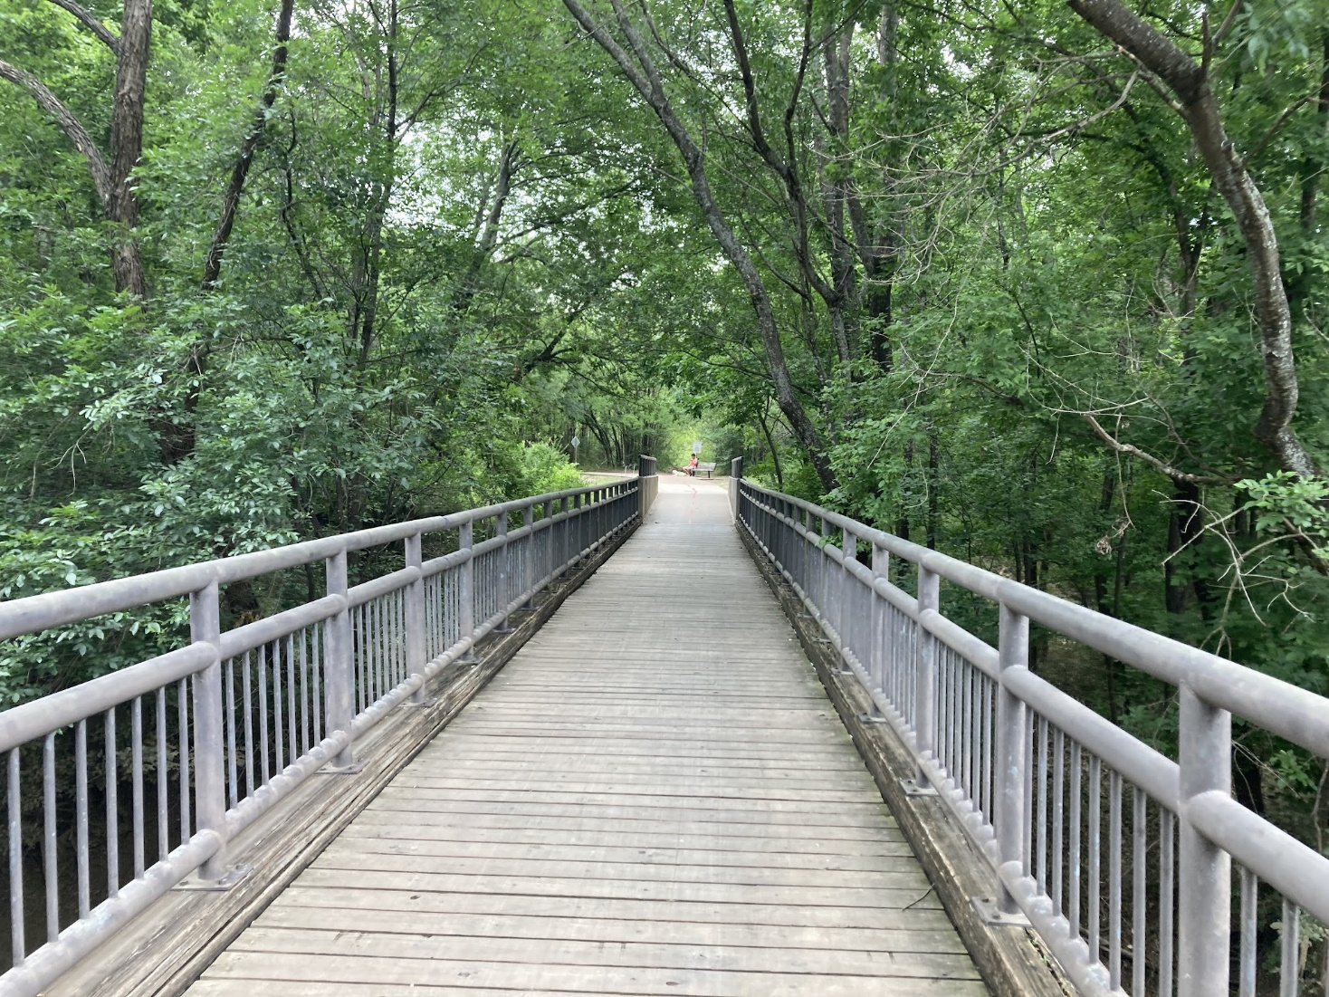
PUBLIC INPUT HIGHLIGHTS
Trail use/experience: peace and quiet, active recreation
Colors/Materials: natural, traditional, stone
Local Images/Elements: Trinity River, flora/fauna, bridges
Branding Approach: Welcoming, friendly, modern, natural

Slide 8
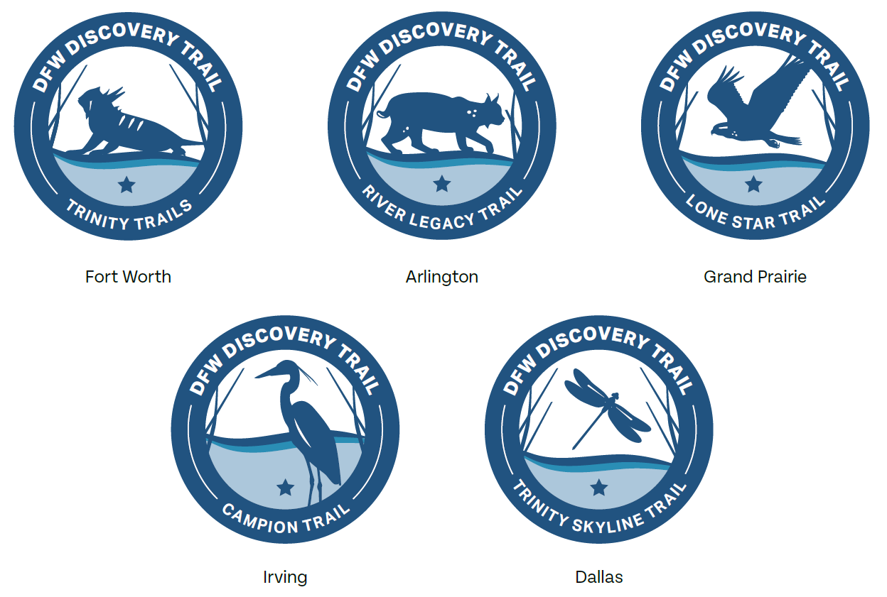
FINAL NAME AND LOGOS
DFW Discovery Trail
Overall Trail Logo:
Jurisdictional Trail Logos:

Slide 9
LOGO USAGE GUIDANCE

Slide 10
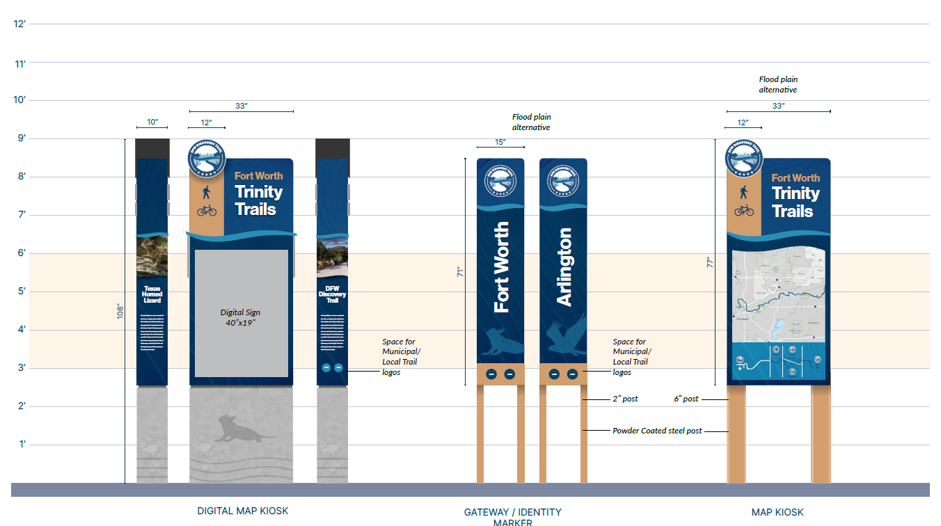
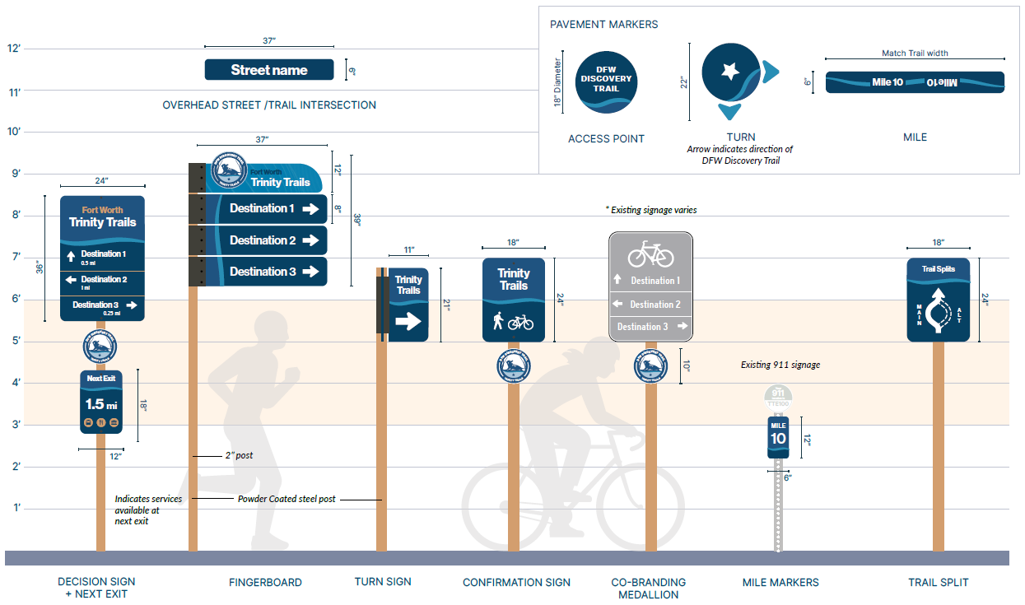
WAYFINDING SIGNAGE FAMILY
Access Elements
Functional and Enhanced Navigational Signs
Informational Kiosks

Slide 11
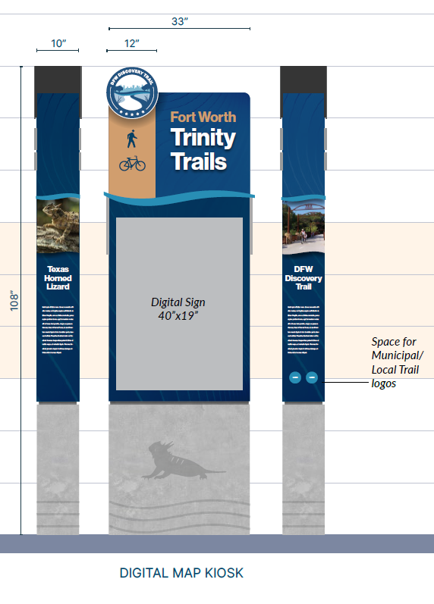
RECOMMENDATIONS
911 Recommendations:
Keep existing 911 signage by jurisdiction
Grand Prairie implement 911 signage
Lighting Recommendations:
Natural state of the trail does not require full lighting
Priority areas with key commute or first/last mile routes
Design considerations to avoid environmental impacts, such as angled down/shielded to direct lighting
Solar lighting an option in flood-prone areas
Digital Map Kiosks
Ensure trail users have the most up-to-date information
Integrated trail counters
Recommended locations – one per city

Slide 12
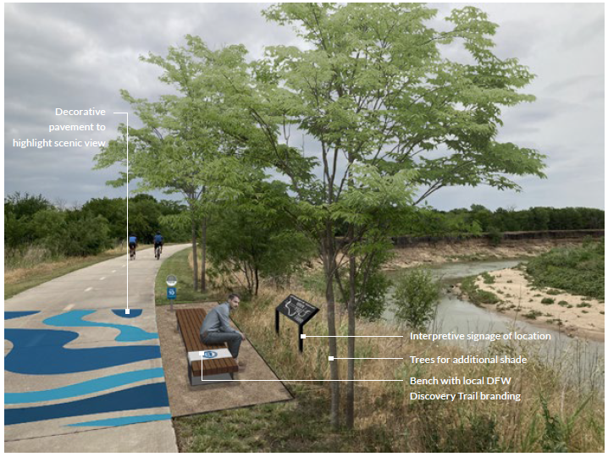
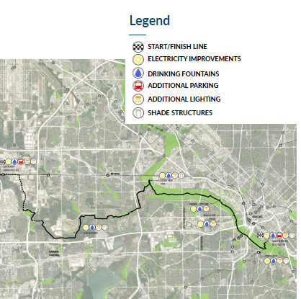
RECOMMENDATIONS
Event Recommendations:
Infrastructure recommendations in strategic locations to host a variety of events on the trail
Conceptual race routes in the five cities using the trail
Placemaking Recommendations
Typologies: economic development, community gateways, resting and play, scenic vistas
Public art opportunities
Trail Maintenance, Management, and Operations Recommendations
Case studies of peer trails’ organizational structures
Information on establishing regional trail management structure with different scenarios
12

Slide 13
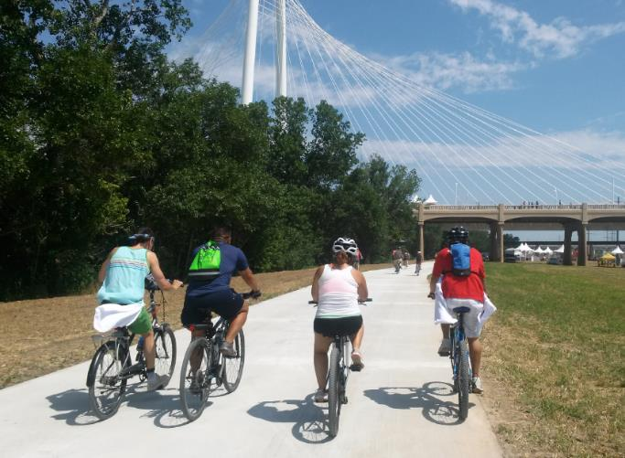
NEXT STEPS
Trail Completion
Most sections of trail anticipated to be complete in 2024
Additional branding and wayfinding implementation strategies will be developed as trail moves toward completion
Wayfinding Signage Fabrication
Developed design intent drawings to allow sign fabricators to develop an accurate bid for cities
Cities can use to implement signage as trail segments are completed or upgraded
Trail M&O
Exploring option of Trinity Coalition taking on role of umbrella organization

Slide 14
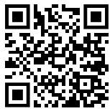
MORE INFORMATION:
DFW Discovery Trail
www.nctcog.org/dfwdiscoverytrail

Slide 15
CONTACT US:
Shawn Conrad, PhD
Principal Transportation Planner
North Central Texas Council of Governments
sconrad@nctcog.org
Karla Windsor, AICP
Senior Program Manager
North Central Texas Council of Governments
kwindsor@nctcog.org

